Slide 1


WELCOME MEETING FOR PARENTS OF CHILDREN STARTING SCHOOL IN SEPTEMBER 2026
Holywell Village First School:
Making Learning an Adventure

Slide 2
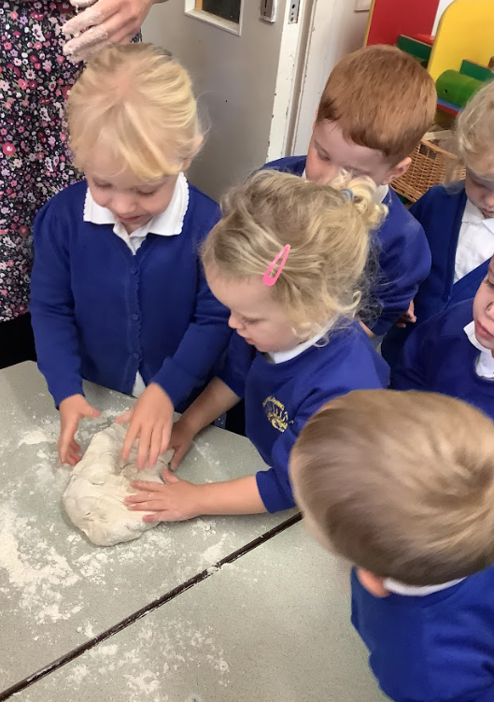
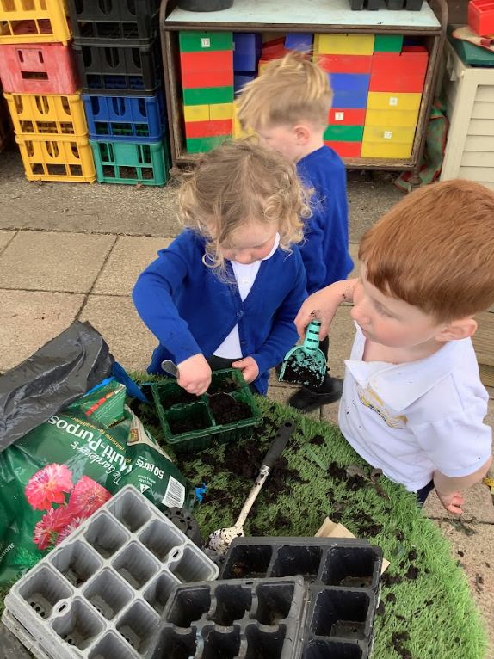
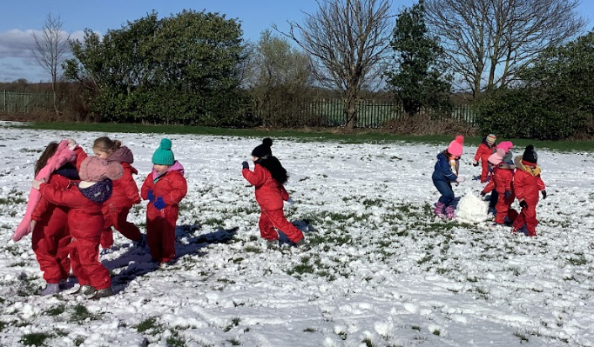
Our vision for pupils at our school:
At Holywell Village First School we have high aspirations for our children to become well-rounded, respectful and responsible future citizens. They are happy, independent and have positive self-esteem. They have a thirst for learning and are emotionally regulated so they are ‘Ready to Learn’. They are curious about the world around them and are confident to ‘have a go’. They are reflective learners who persevere and demonstrate good communication and social skills. They are thoughtful, caring and kind.

Slide 3
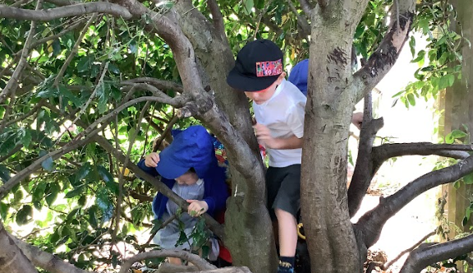
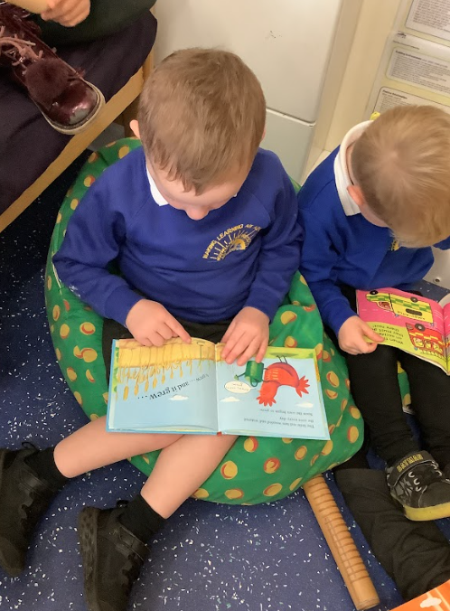
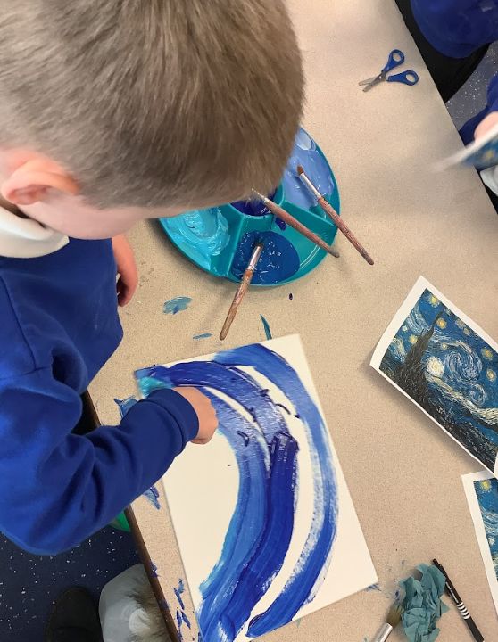
Our Ethos
Everyone thing we do is through the lens of our 3 Core Values. We ask ourselves the following 3 questions:
Are we being respectful?
Are we being thoughtful, caring and kind?
Are we ready to learn?
OFSTED Jan 2025:
Pupils at Holywell Village First School embody the school’s values of being ‘respectful’, ‘ready to learn’ and ‘thoughtful, caring and kind’. Pupils show high levels of respect for all, including those different to themselves. They speak politely and confidently with visitors and describe how much they enjoy school.

Slide 4
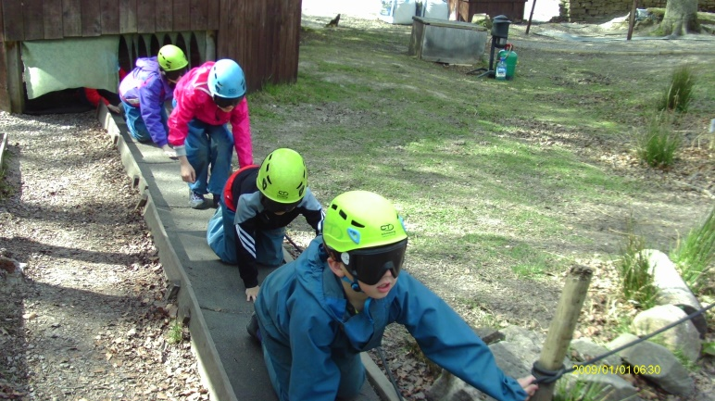
How we aim to deliver our vision
We will:
Provide a safe environment where children will be challenged and encouraged to ‘have a go’
Through our relationships with each other we will be good role models
Through our wider curriculum children will develop good personal and social skills
Foster strong, positive and long-lasting partnerships with parents, carers
and the wider community.

Slide 5

OUR UNIQUE CURRICULUM IS KEY TO DELIVERING OUR VISION

Slide 6
OFSTED Jan 2025:
The school’s ambitious curriculum gives all pupils many rich opportunities to develop new knowledge. For example, children use maps to plan out a cycle route to the coast. They then ride bikes on the trail they have planned. Pupils can remember previous learning in extraordinary detail. Over time, pupils learn to describe complex ideas extremely well. Pupils are very well prepared for the next stage in their education.
The highly ambitious curriculum has been well designed to support learning from the early years upwards. The school offers pupils a wide range of valuable experiences that make learning memorable.

Slide 7


WE WANT OUR CHILDREN TO BE THE BEST THAT THEY CAN BE

Slide 8
Key People
Head Teacher & Deputy:
Mrs Sarah Brett & Mrs Samantha Endacott (acting Headteacher 2026-2027 academic year)
Governors:
Mr Dave Anderson (Vice Chair - parent) Mrs Angela Hall (Chair of Governors), Mrs Sandra Hogarth (staff) & Mrs Samantha Endacott (teacher), Rev David Atkinson (Co-opted) Mr Martin Swaffield (parent) Mrs Emma Williamson, Mrs Sarah Hornby (Parent Governor representative)
Mr Adrian Dougherty, (Parent -Associate Governor)
Office staff:
Mrs Emma Reed - School Manager
Nursery and Reception staff:
Mrs Leanne Saxton, Miss Caroline Orchard, Mrs Joy Bramley, Mrs Juliet Freel & Miss Kayleigh Harrison

Slide 9
Parent Governors –What is their role in school?
Make strategic plans for school improvement
Formulate policies to make sure improvements happen
Visits into school to monitor and evaluate leadership and management
Visits into classes to monitor subject areas
Check data, performance management etc
Give a parental viewpoint to inform decision-making in school
Respond to parental queries on behalf of the governing body- formal and informal

Slide 10
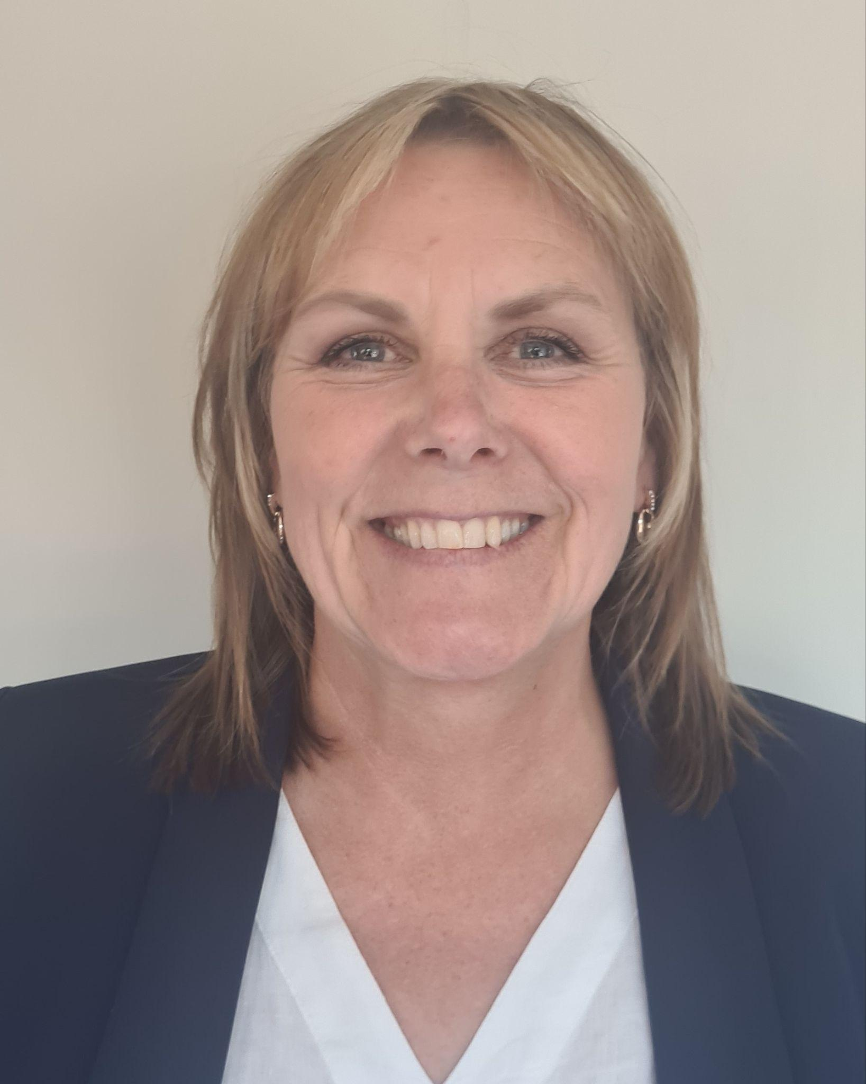
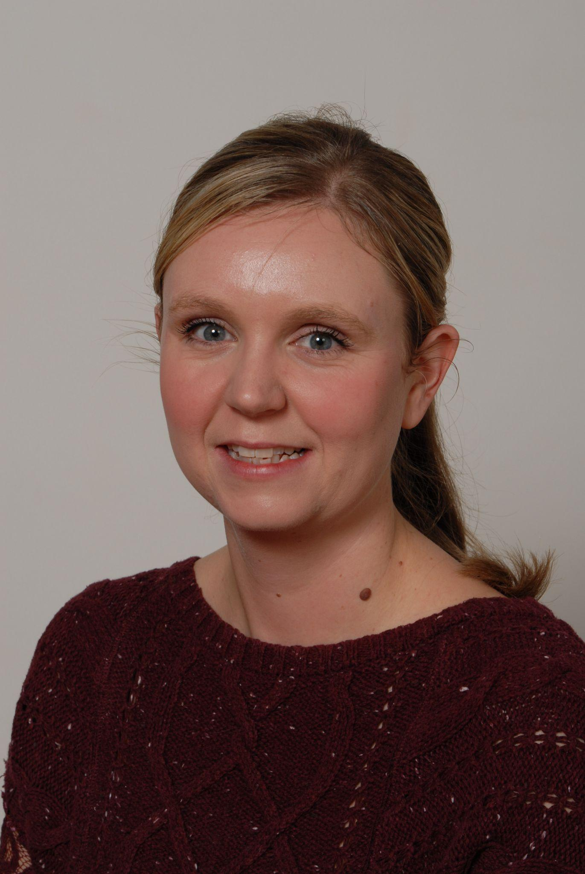
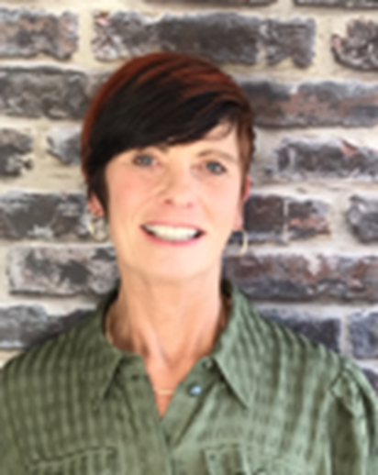
Meet the Early Years staff:
Mrs Joy Bramley
Nursery Teacher
Mrs Leanne Saxton
Reception Teacher
Miss Caroline Orchard
Reception Teacher

Slide 11
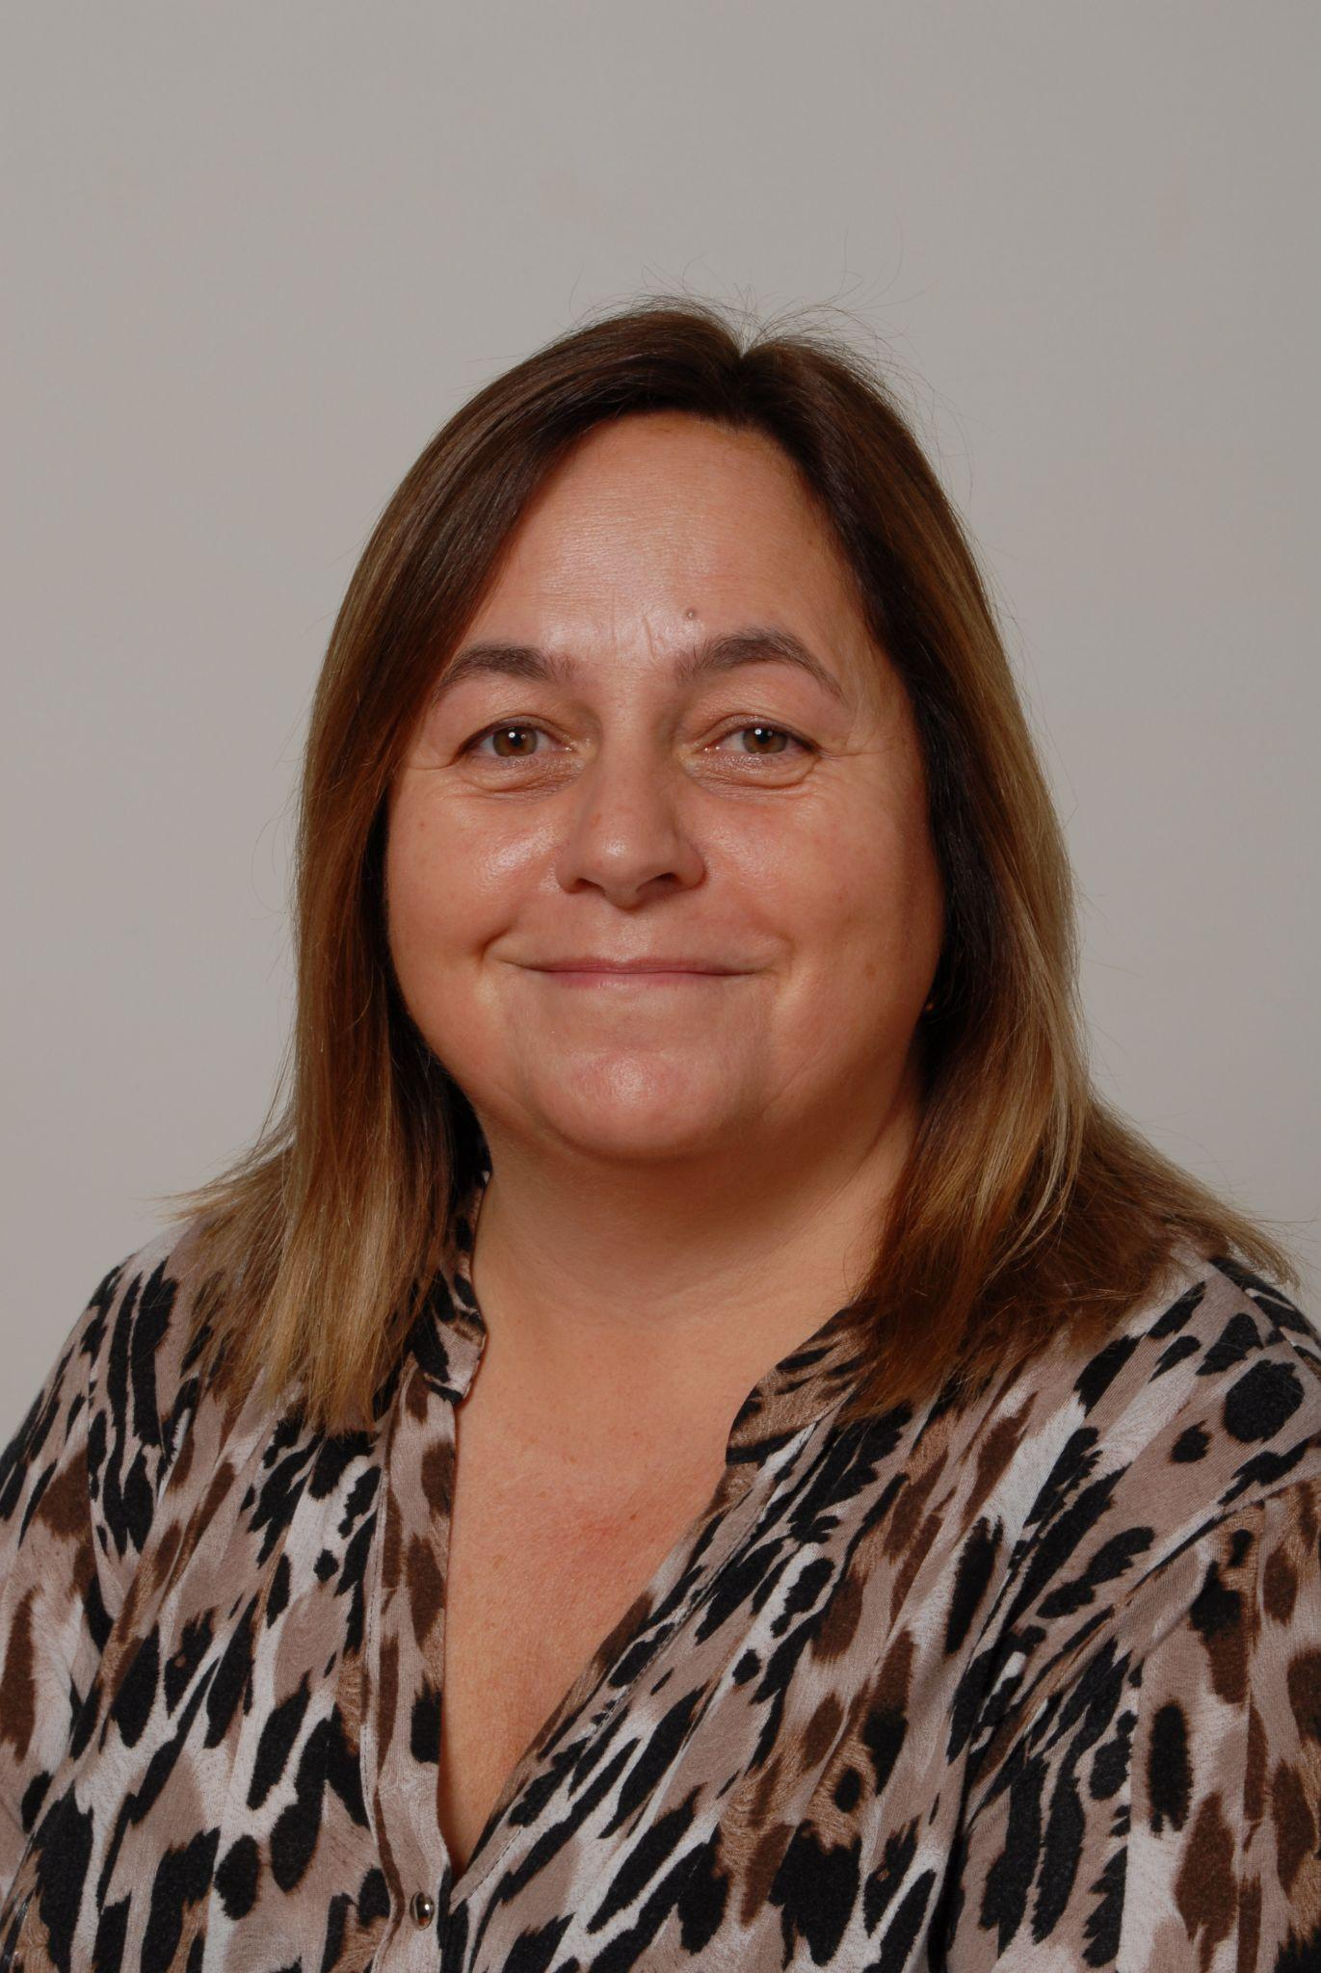
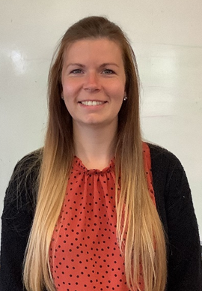
Mrs Juliet Freel & Miss Kayleigh Harrison
Learning Support Assistants

Slide 12

Wraparound care: our on-site partner is:
At Chill Out Time Childcare we will develop confidence, self-esteem and independent thinking in the children we care for. Through child-centred play as a starting point, we will extend your child’s first learning experiences relevant to them and fill their day with creative and positive experiences, through our varied and challenging curriculum.
Current provision is:
7:30 am - 9 am
12 pm - 6 pm

Slide 13
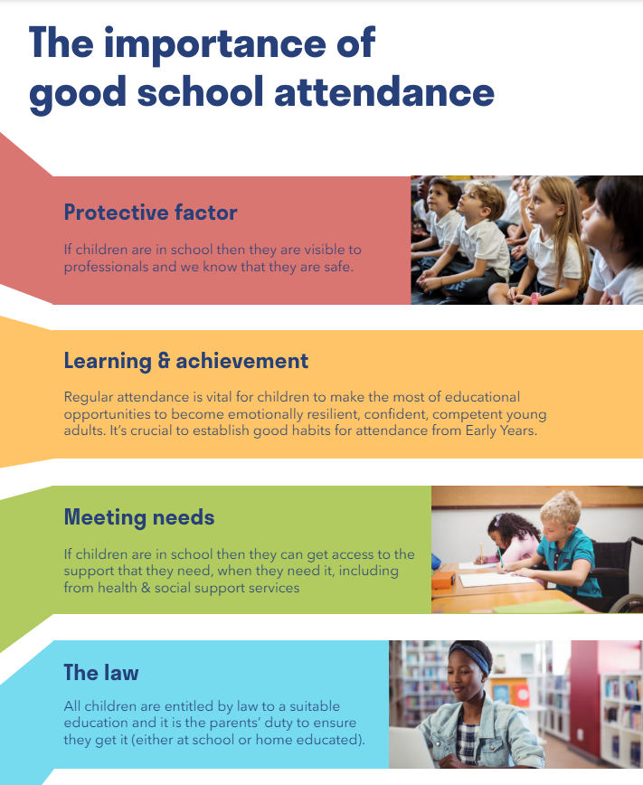
The boring bits …
Attendance:
Even if your child is not compulsory school age, we do expect excellent attendance and authorise absences only in the most exceptional circumstances (Attendance Policy ‘New Starters’ section on our website).

Slide 14
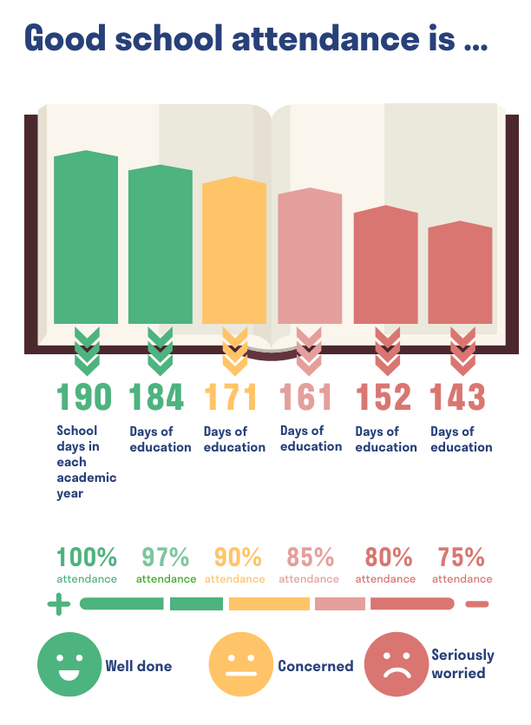

Slide 15
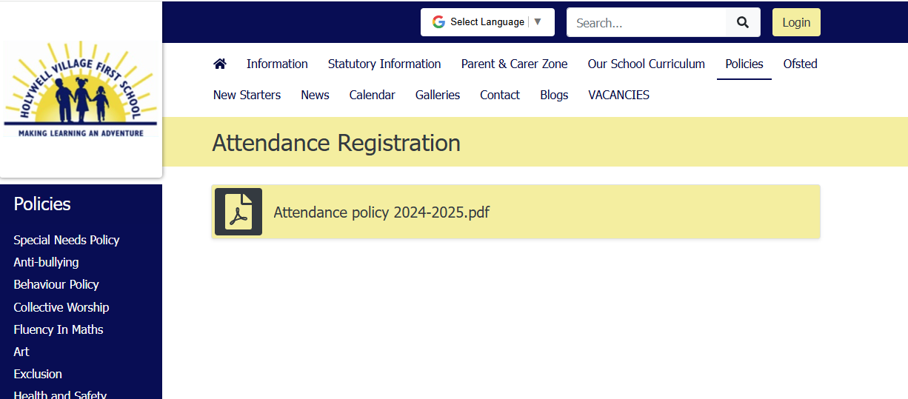
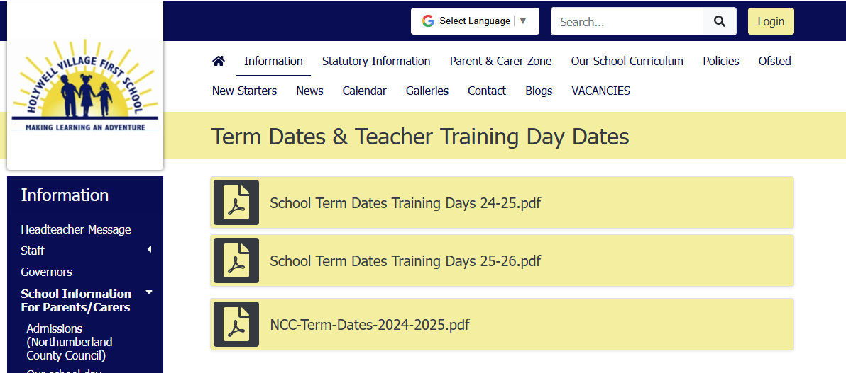
Holidays
Holidays are great! We think everyone should have holidays!
We're sure you know that we want children to experience the joys and discoveries of holidays of all kinds and we're also sure that you know we want children to have the best possible start to the rest of their lives - that's our core purpose.
In order to do the best job we can and to give your children the best education we can, we don't want them to miss out on any of our carefully planned and sequenced curriculum, so we do not authorise children having holidays in term time, unless there are special or exceptional circumstances.
If you need to take your child out of school for a holiday, please complete a ‘Request For Leave Of Absence’ form available on the website or from the school office. It is unlikely that the holiday would be authorised and therefore your child's absence would be recorded as unauthorised. If any child has too many unauthorised absences, an Educational Welfare Officer will be involved to investigate, which may lead to a penalty notice being issued to the parent/s.
Please also see our Attendance Policy. You might also be looking for our list of term dates and school holidays, which you will find on the Term Dates page.

Slide 16
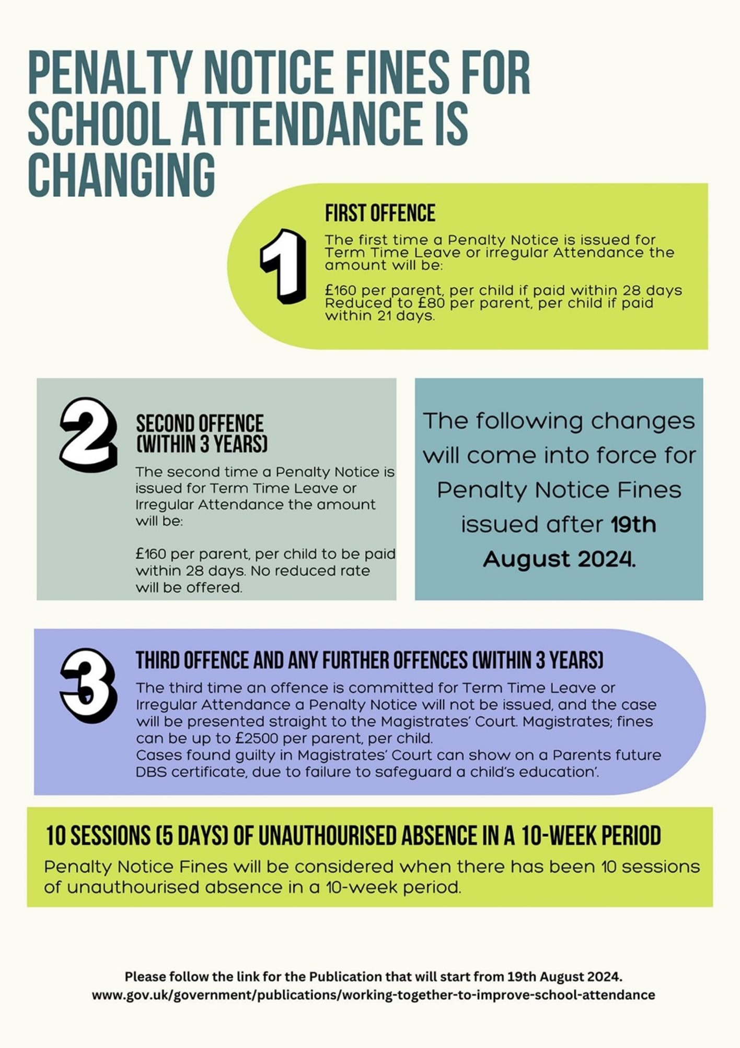

Slide 17
Punctuality
Why do children need to arrive on time for school?
Your child’s education is important and being late will mean:-
● Missing the beginning of lessons
● Not hearing important information about school and lessons. This could mean your child not being able to complete work because they were not given vital information
● Your child being embarrassed at having to enter a room where a lesson has already started
● Being late for the start of important assessment work
● Your child failing to learn important knowledge, life skills; employers will expect good time keeping and children need to learn this from an early age.
Reception starts at 8:55 am
Nursery starts at 9:00 am

Slide 18
We request that you read all of the required information and user agreements (and return signed forms) prior to your child starting school in September…….
Without data collection sheets and consent forms returned, we cannot set you up on our systems to share information over the summer e.g. important emails, school meals etc.
Please return them no later than 13th July.
Please ensure you have completed the Parental Declaration form for funding entitlement within the pack (Nursery only) and return these to school as soon as possible. Any queries, please speak to Mrs. Reed

Slide 19
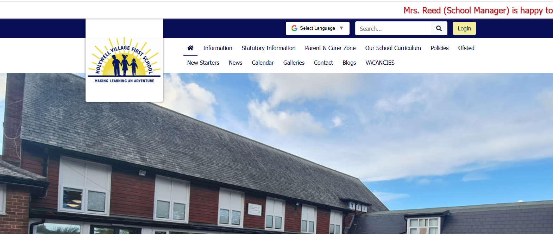
www.holywell.northumberland.sch.uk
Click on ‘New Starters’ tab and all of the information and user agreements you are required to read are here.
Once you have read these, please complete the signed declaration within your New Starters pack and return to school by 13th July 2026 at the latest.

Slide 20
Communication
We communicate in many ways, mostly electronically via email and via the website.
Please see Mrs Reed if you have any issue with accessing internet/data or problems receiving information electronically/accessing websites etc.
e.g. some people may have dyslexia and find accessing written message a challenge.
parents/carers may be visually or hearing impaired

Slide 21
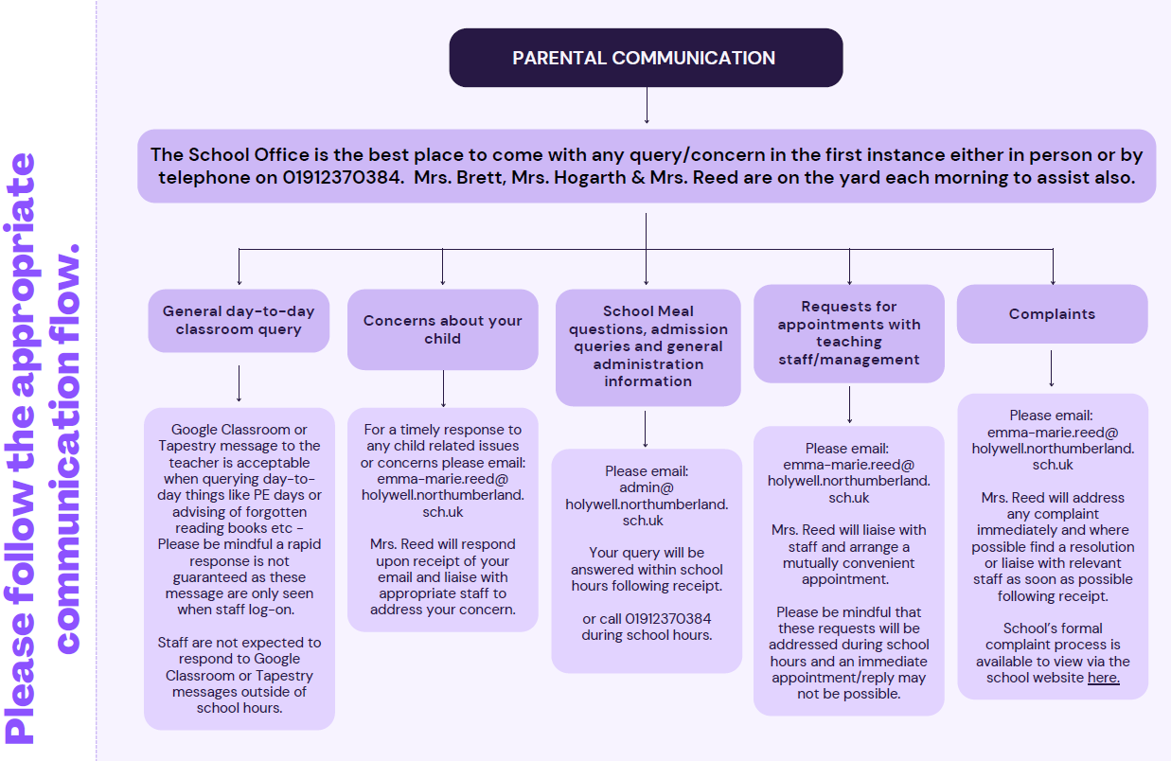

Slide 22
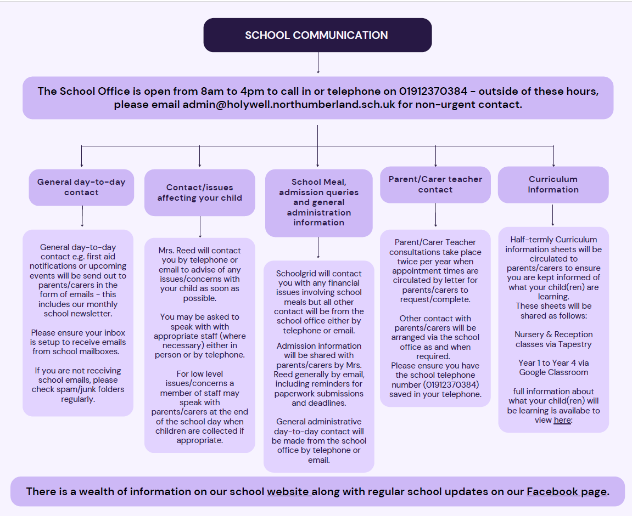

Slide 23
ID verification
It is necessary for us to verify your child’s eligibility to attend Nursery/reception, so please bring your child’s birth certificate when you next visit school.
Alternatively you can scan/photograph and send a copy via the school email address:
admin@holywell.northumberland.sch.uk.

Slide 24
A word of caution
Parents of children who get a Nursery place at any Local Authority school MUST re-apply for a place in Reception in the autumn term. We will let you know when the portal is open.
Parents MUST do this because nurseries are not statutory and admissions are administered and allocated by the school. Reception places are part of statutory provision therefore the Local Authority must administer these applications. In this case the authority is Northumberland County Council.
Having a place in a school’s Nursery does not mean you will automatically be allocated a place in Reception.

Slide 25
Current NCC admission policy
In accordance with the School Admission Code, children with a Statement of Special Educational need or an Education Health and Care Plan (EHCP) where the school is named in the Statement or EHC Plan will be given priority of admission. In addition, those children who are deemed to be ‘looked after’ or who have previously been ‘looked after’ will be given priority of admission.**
1. Children living within the catchment area of the school and those on whose behalf firm evidence is presented that they will be living in the catchment area by the appropriate admission date.
2. Children with an exceptional social or medical reason that means that they can only attend that specific school (for example, where the child or one or both parents has a disability that means that the child can only go to one school).
3. Children resident in the greater catchment area of the school partnership who have siblings already in the school and who are expected to be on roll at the school at the time of admission who live within the greater catchment area of the school partnership. Evidence must be presented to confirm that the child will be living in the greater catchment area.
4. Children resident in the greater catchment area of the school partnership who are expected to be on the roll at the school at the time of admission. Evidence must be presented to confirm that the child will be living in the greater catchment area by the appropriate admission date.
5. Children who have a sibling who already attends the school and who is expected to be on roll at the school at the time of admission.
6. Children on whose behalf preferences are expressed on grounds other than those outlined above.

Slide 26

School Meals
Will be provided by Dolce
Stay for Lunch – New Reception:
Friday 10th July 2026
Packed Lunch required
Once children commence school, all meals are free for pupils in Reception, Year 1 and Year 2.
IMPORTANT:
From September 2026 we will operate a STRICT nut-free policy within school and therefore please do not send nuts or nut products (e.g. Nutella sandwiches, trail mix, nut cookies etc) in packed lunches.

Slide 27
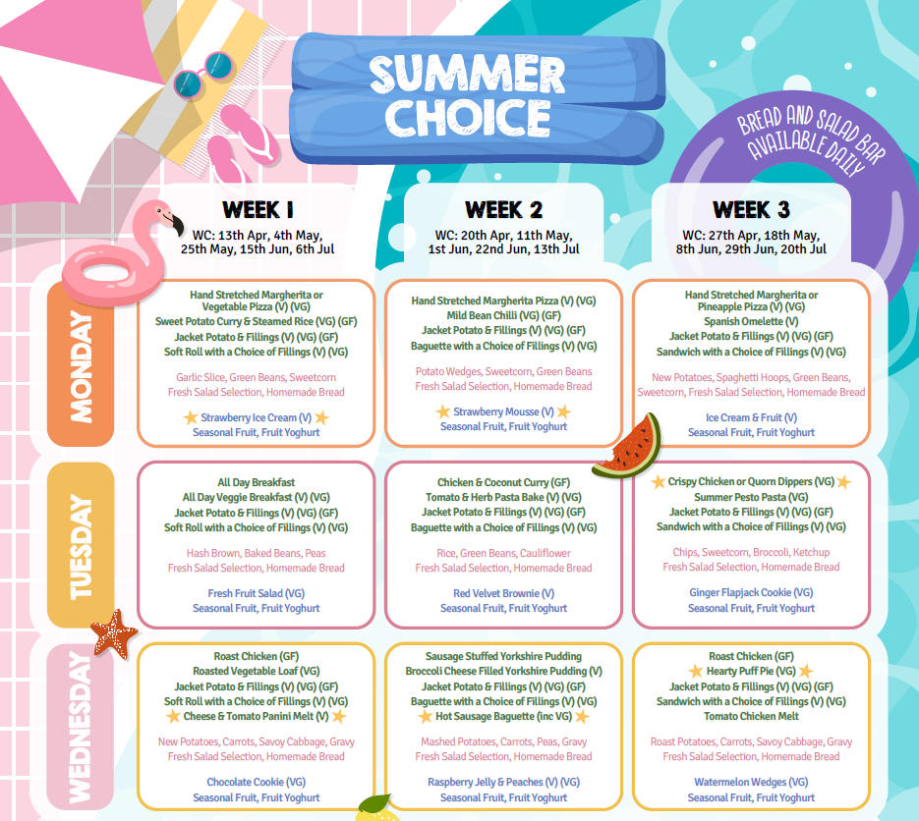

Slide 28
Organisational Issues
Before/after school care – Chill Out Time Child Care
Safety - car park / entrances / visiting the office / gates
School uniform – Ciel School Uniform– online ordering
Milk / lunches
Medical issues – emergency contacts –update us after a change in address/telephone etc.
Parents and Friends Association- SCHOOL FAIR 27TH JUNE 12-4 PM
website www.holywell.northumberland.sch.uk
Facebook page search for @holywellschool on Facebook - will appear as HVFS and logo

Slide 29

Ciel - https://cielschooluniform.co.uk/holywell-village-first-school/

Slide 30
Pre-worn Uniform
Our Parents and Friends Association sell a range of uniform and shoes for a between 50p and £1 per item only.
Please consider purchasing uniform from them to keep the costs down.
Pre-loved uniform sales tend to take place on the first Friday of each half-term and these dates are shared via email with parents/carers in advance.

Slide 31

Arrangements for visiting/starting Nursery
New to Nursery:
Special New Nursery event.
25th June from 1pm to 2pm - look out for the special invitation email this week!
Familiarisation visits for children and parents.
Group 1 - Friday 10th July 2026 9:15 - 10:15 am
Group 2 - Friday 10th July 2026, 10:45 - 11:45 am
Stay and Play for children.
Thursday 3rd September 2026
Group 1 - 9.15 - 10.15 Group 2 - 11am to Midday
Group 1 children start nursery on 04.09.26
Group 2 children start nursery on 09.09.26

Slide 32
Arrangements for visiting/starting Reception
New To Reception:
Familiarisation visit & stay for lunch (for current Nursery-aged children starting Reception only.)
Friday 10th July, 9am to Midday
Bring a packed lunch
Children will start Reception on Thursday 3rd September 2026.
Children will start at 8.55am and stay until 3pm.

Slide 33
Parental Involvement
‘Parents are a child’s first and most enduring educators’ EYFS
‘Every child deserves the best possible start in life and the support that enables them to fulfil their potential. Children develop quickly in the early years and a child’s experiences between birth and age five have a major impact on their future life chances. A secure, safe and happy childhood is important in its own right. Good parenting and high quality early learning together provide the foundation children need to make the most of their abilities and talents as they grow up.’

Slide 34

Parents as partners
Tapestry (more information will be provided by the class teacher):
An easy-to-use online learning journal, Tapestry helps educators and parents to record, track and celebrate children's progress in early years education.
Nurseries, pre-schools and reception classes are fun-packed and busy. From messy play and first steps to learning phonics and new games, there's so much for children to do, learn and take in.
Tapestry enhances this special time, helping teachers and practitioners to capture children's experiences as well as monitor development and learning. This unique journal is shared online with parents, who are able to see special moments and view their child's progress.
Text, images and videos can be easily uploaded via PC, tablet or our mobile app - anywhere there's an online connection. Every entry helps to create a complete story of a child's time at nursery, pre-school or school. MORE INFORMATION TO FOLLOW

Slide 35



Reading
Parents can improve their children’s academic performance by the equivalent of up to six months’ schooling by reading together, singing songs and even sharing family meals, according to international research.
The Book Trust 2020
Regularly reading to a child for the love of it provides a connection between parent and child from the very early days and helps build strong family ties. Lines from favourite stories enter the family lexicon. Families who enjoy reading together have more opportunities for discussion, developing empathy and attachment. Reading to their infant is one of the greatest gifts parents can give. By starting the journey of building a lifelong love of reading for pleasure, parents are giving their child the opportunity to be the best they can be: children who read for pleasure do better in a wide range of subjects at school and it also positively impacts children’s wellbeing.

Slide 36

Toilet Training

Slide 37

NHS APP
This is a poster about the Growing Healthy 0-19 app. In the app there is a function called Health Chat which is our messaging service. If a parent/carer needs to contact a health visitor about anything at all they can use this function with their questions responded to during office hours, Monday to Friday. We would urge anyone to use this so they’re not waiting for a call back from their named health visitor who could be on annual leave or, in some instances, left the service.

Slide 38
Health and Nutrition
Nursery and Reception:
Water only (no juice or flavoured water)- school food and health policy in line with NHS guidance.
Snack - in line with Nutrition guidance and Fruit for School Scheme.
Milk - free up to the term BEFORE they turn 5. After that, parents/carers have the option to purchase milk term by term.

Slide 39
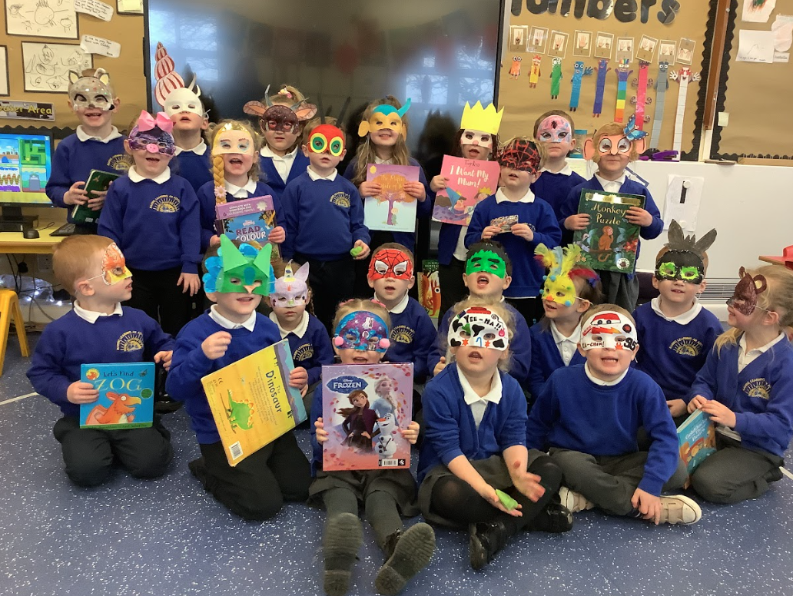
What makes Holywell Village First School unique?
Outdoor, practical, physical, healthy, outward-looking, innovative (Creative Curriculum, Seaton Valley Sports Partnership, Platinum Mark for Sport, Bike it Bronze award, Mastery in Maths school, research for education trusts (Newcastle Research School, Education endowment Fund)
A curriculum that is led by children’s interests
Parental & community involvement (church, pond, community centre, care home, allotments)
Active PTA who help us provide lots of ‘above and beyond’ experiences for children
Safety is paramount – CEOP (e-safety) ambassador, Anti-bullying awards, NSPCC
Happy children!

Slide 40
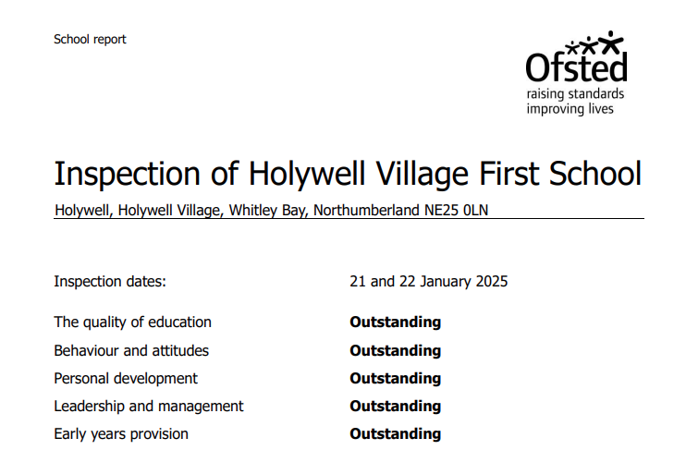

Slide 41

Need more tips?
BBC Bitesize has a great site with short explanations about understanding starting school (staring Early Years & Starting Primary School).

Slide 42


Slide 43

One final plea….
As you may be aware, funding in schools is at crisis point.
How can you help?
If you are in the following circumstance you can help school by applying for free school meals so school can claim Pupil Premium:
Income Support
income-based Jobseeker’s Allowance
income-related Employment and Support Allowance
support under Part VI of the Immigration and Asylum Act 1999
the guaranteed element of Pension Credit
Child Tax Credit (provided you’re not also entitled to Working Tax Credit and have an annual gross income of no more than £16,190)
Working Tax Credit run-on - paid for 4 weeks after you stop qualifying for Working Tax Credit
Universal Credit - if you apply on or after 1 April 2018 your household income must be less than £7,400 a year (after tax and not including any benefits you get)
If you think you can help, please see Mrs Reed.

Slide 44
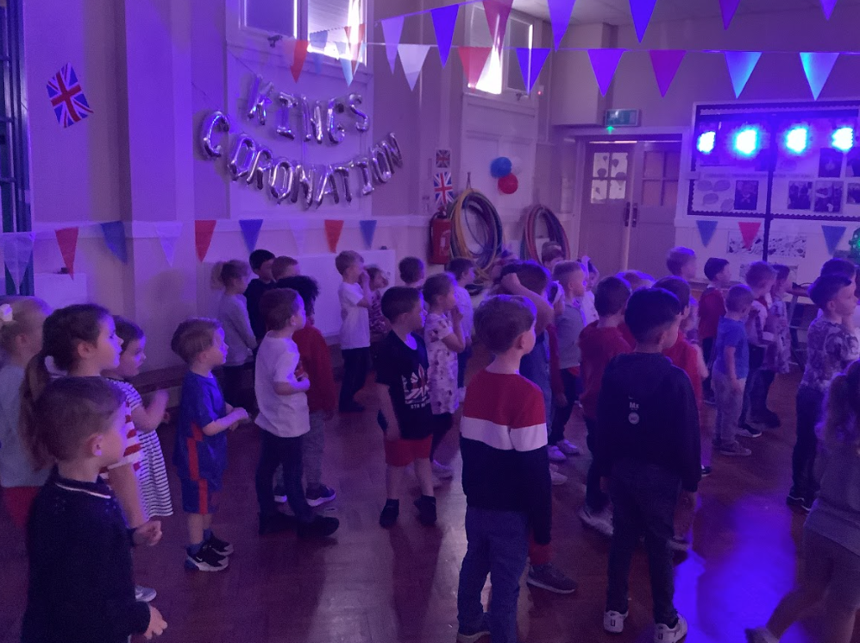
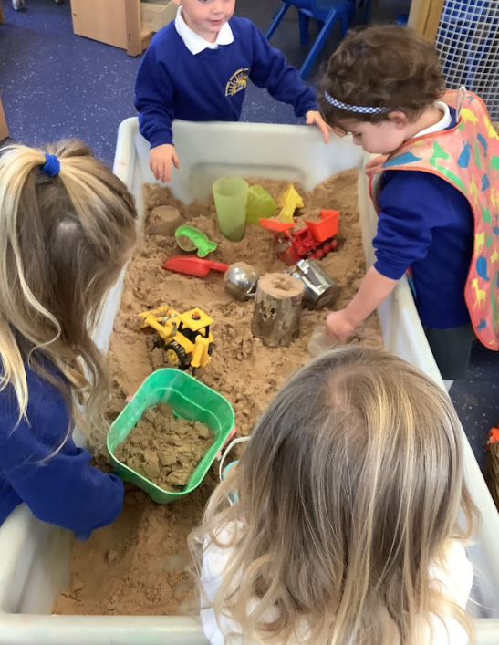
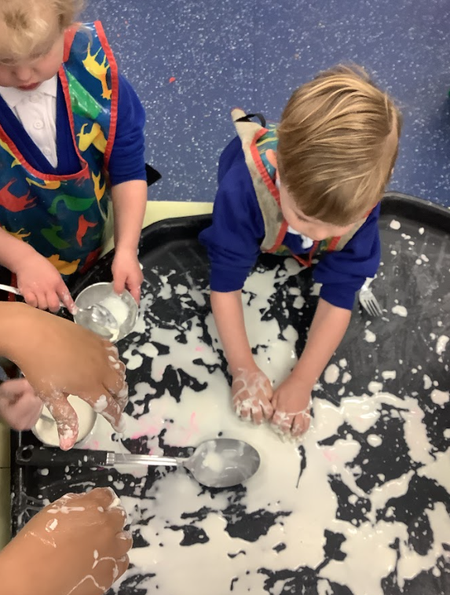
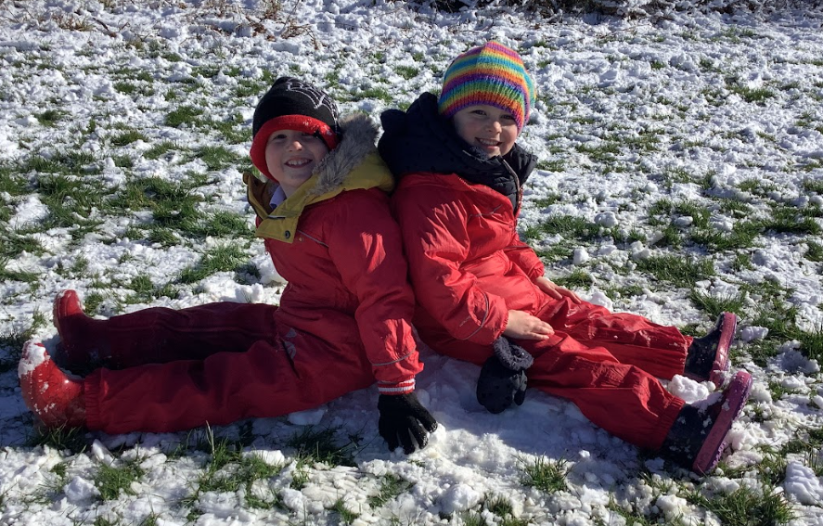
Making
Learning
an
Adventure!

